Slide 1


Docker Assignment
Presented By : Sumit Singh
Emp ID: 1561

Slide 2
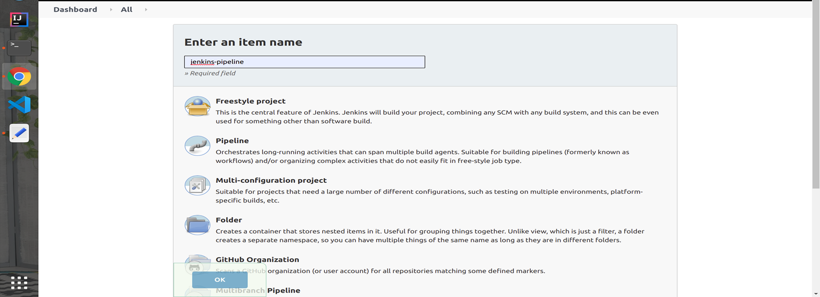
Step 1:

Slide 3
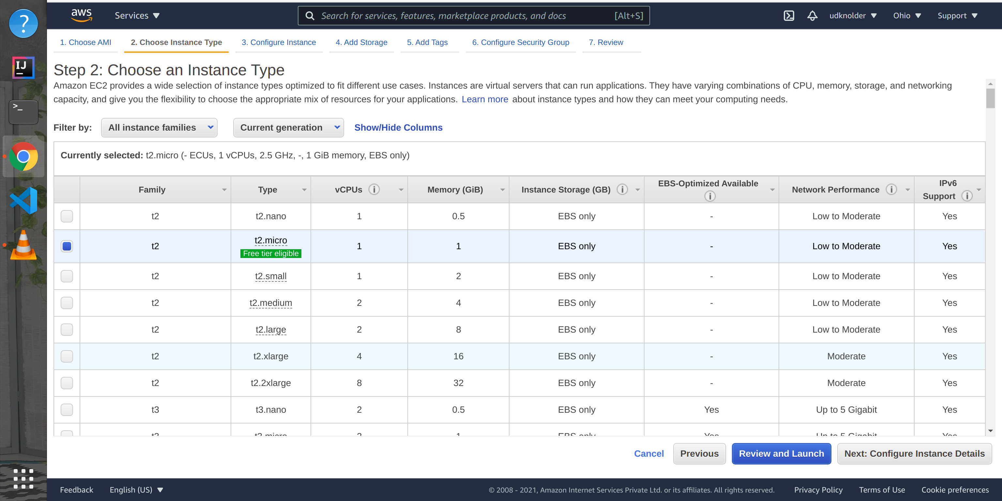
Step 2:

Slide 4
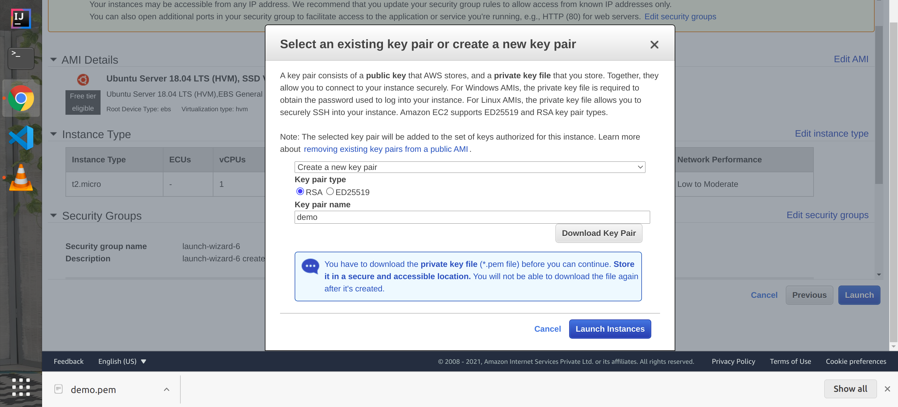
Step 3:

Slide 5
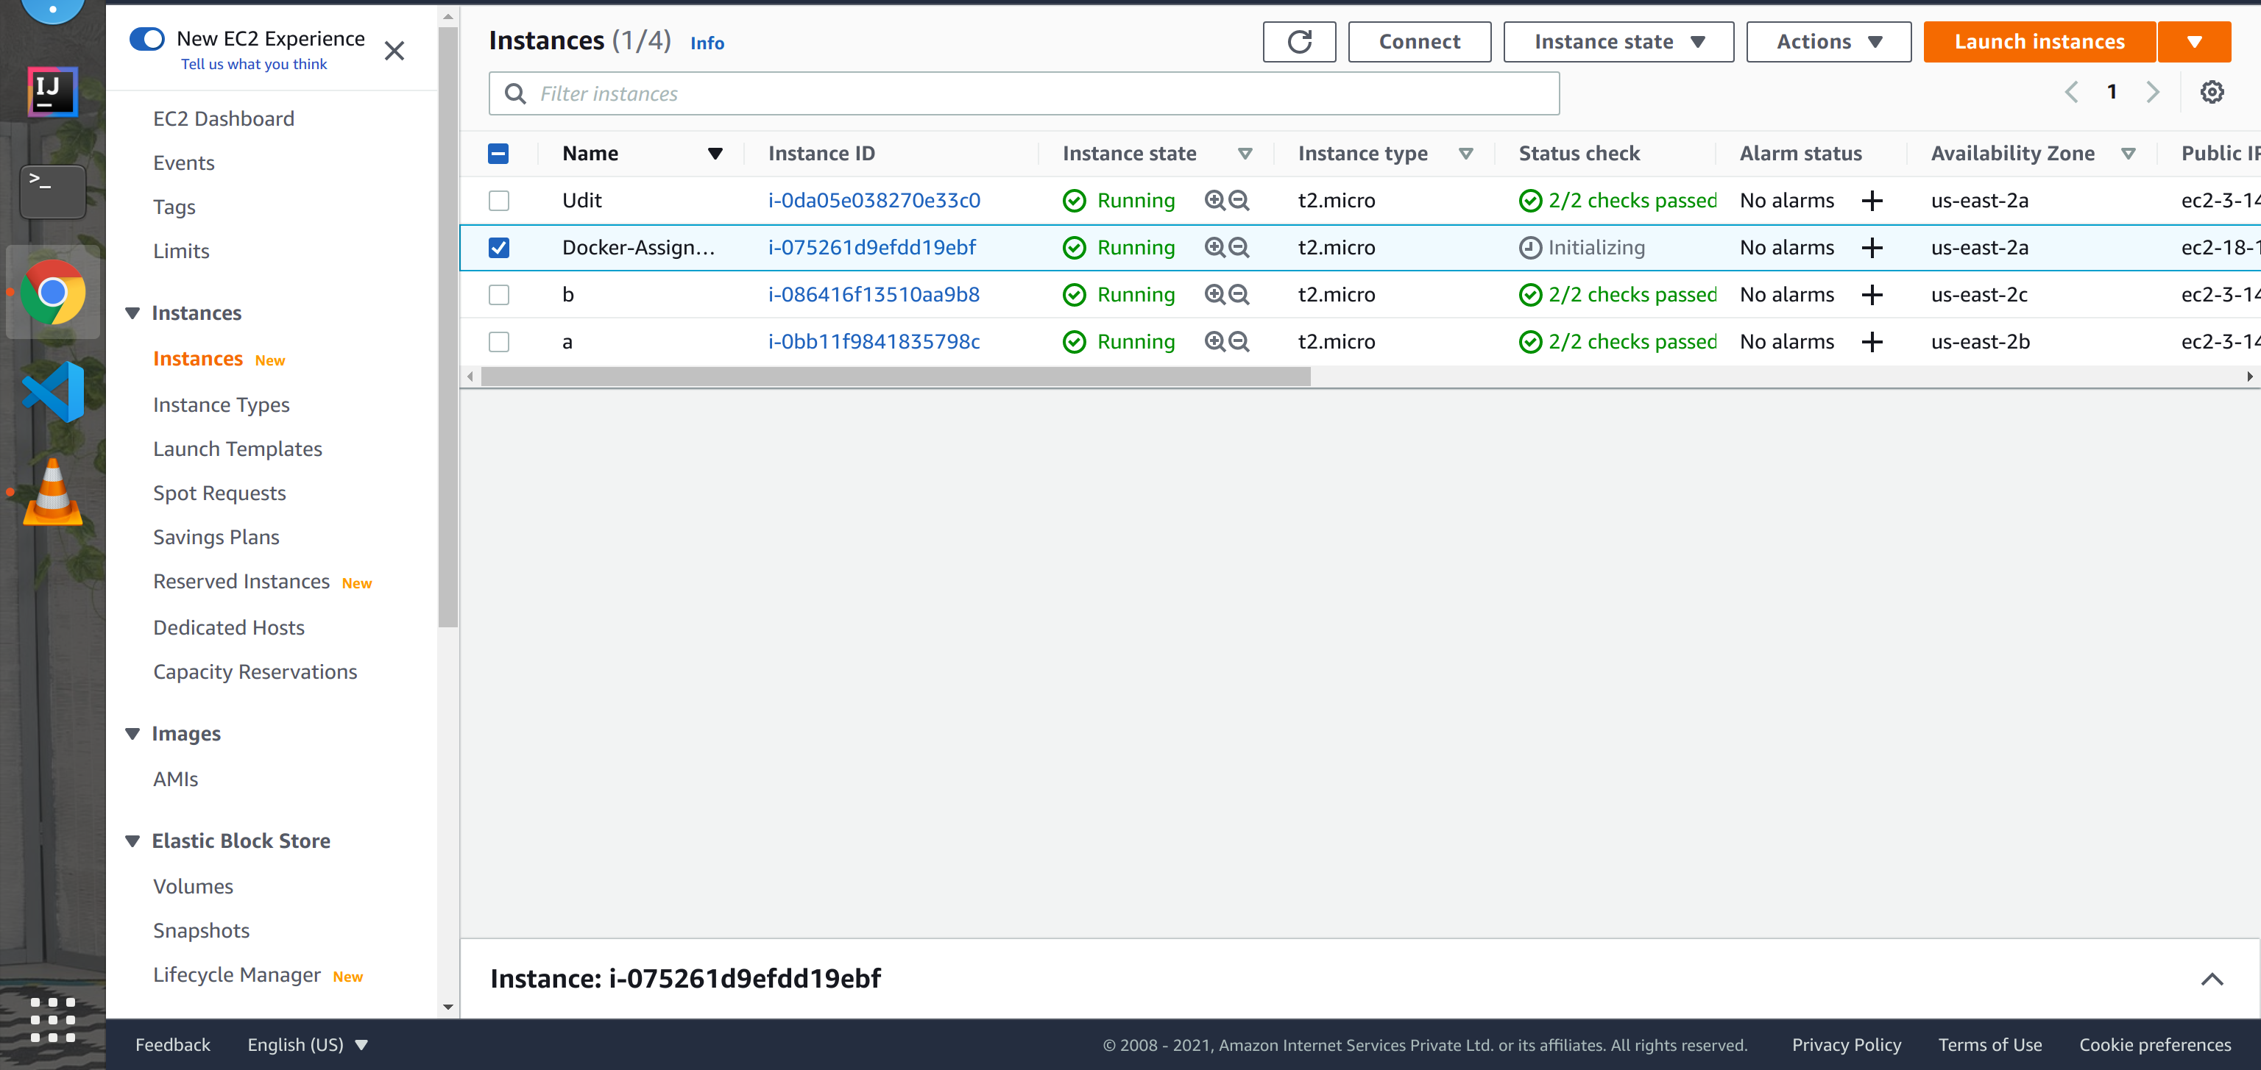
Step 4:

Slide 6
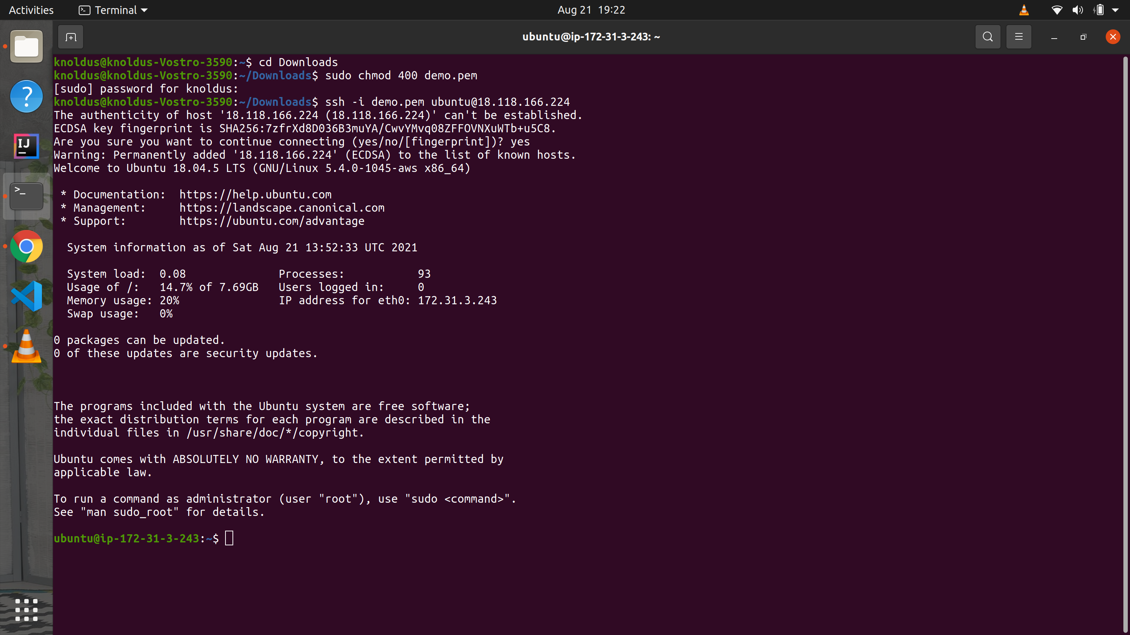
Step 5:

Slide 7
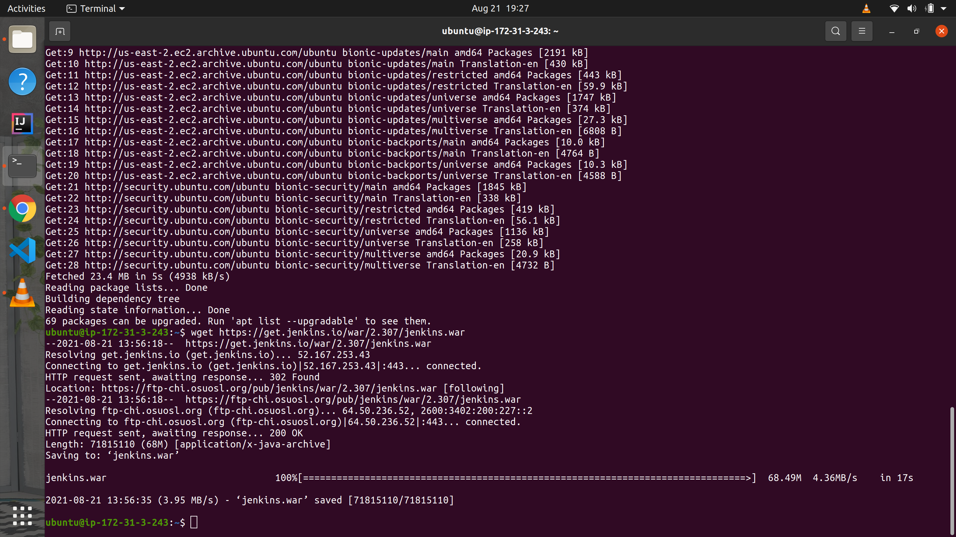
Step 6:

Slide 8
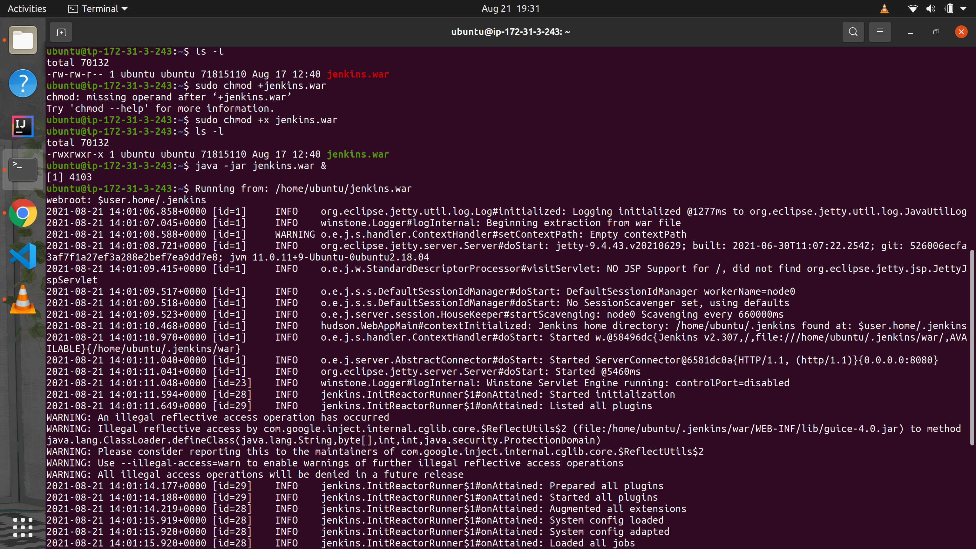
Step 7:

Slide 9
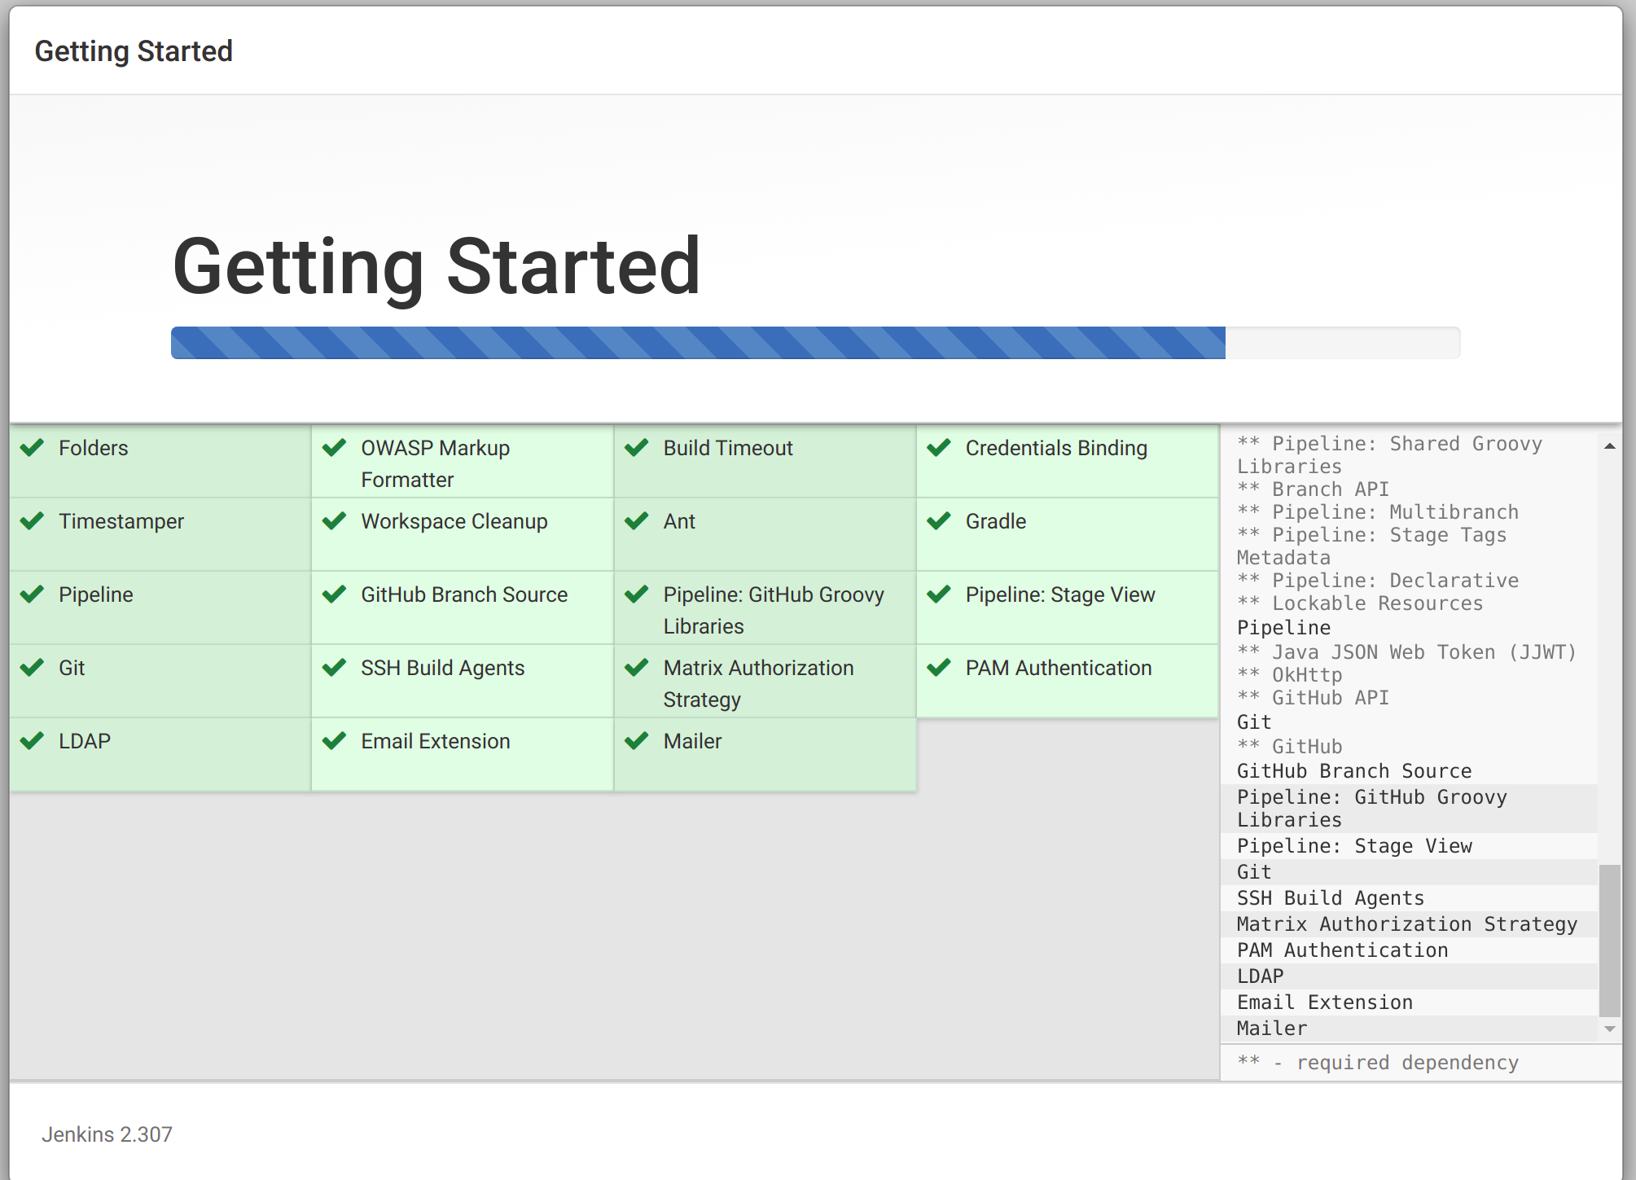
Step 8:

Slide 10
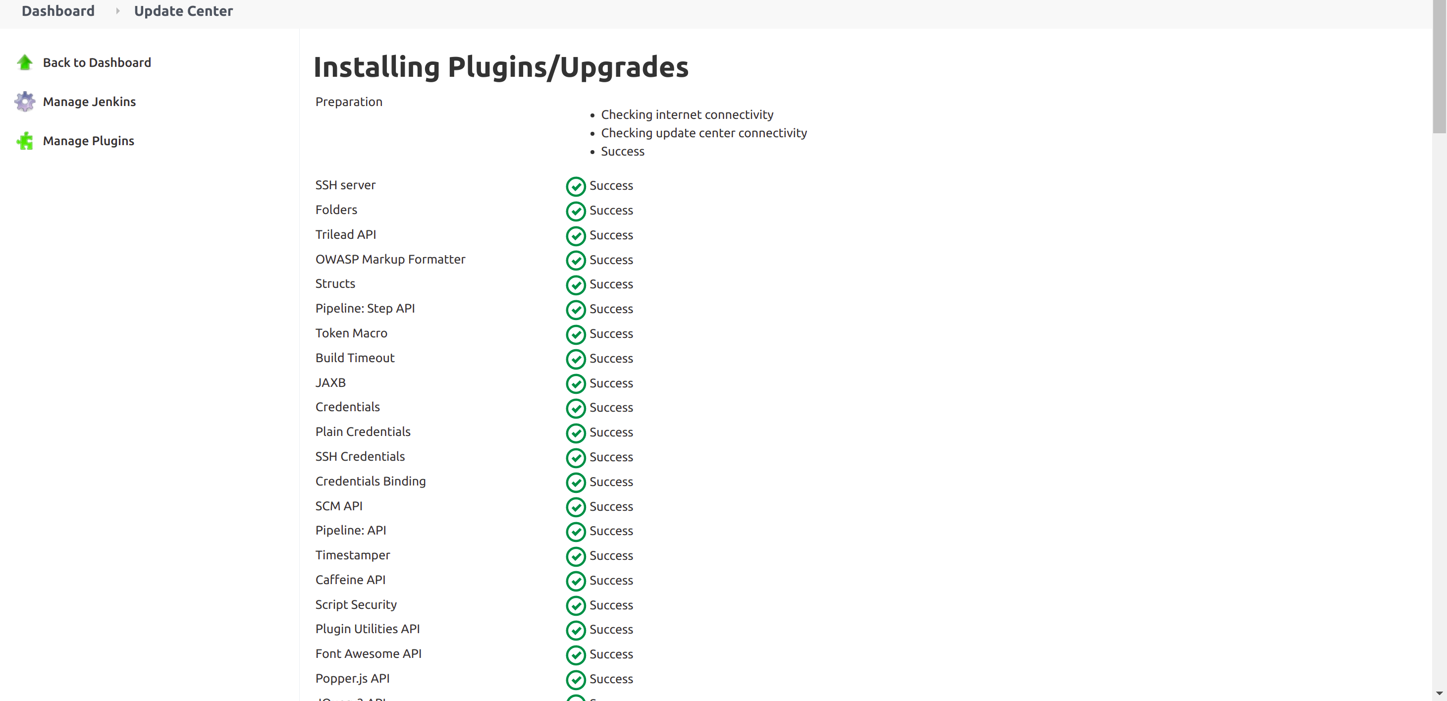
Step 9:

Slide 11
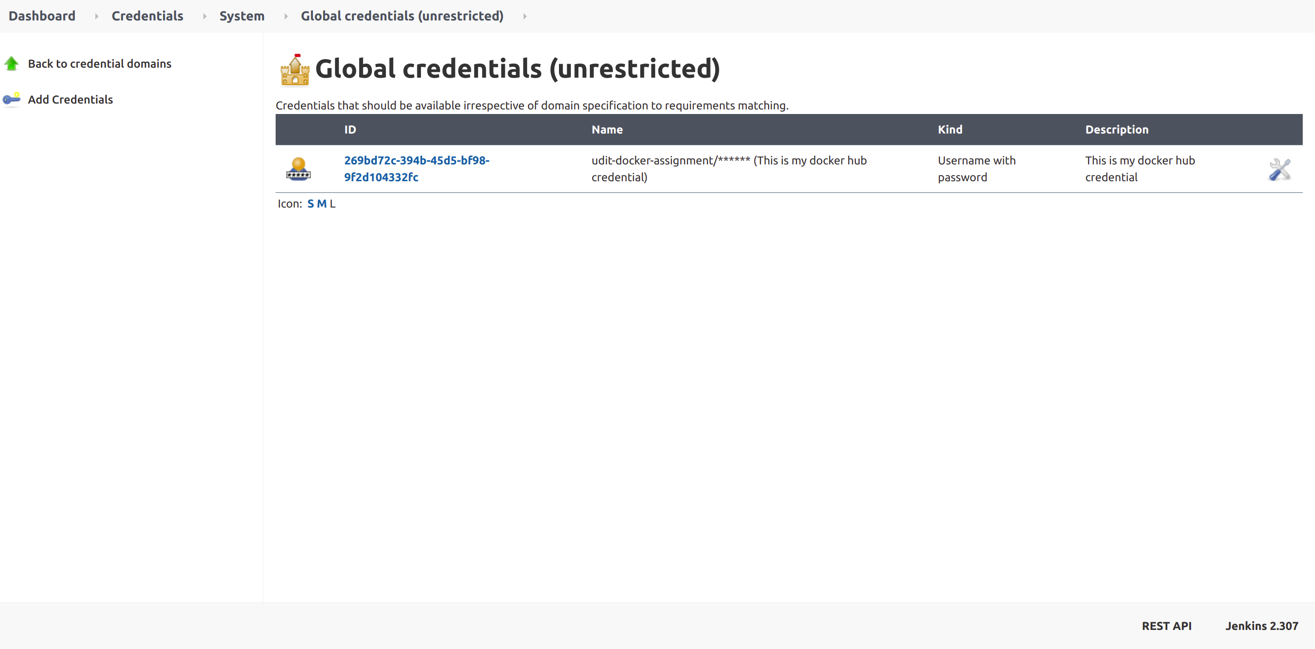
Step 10:

Slide 12
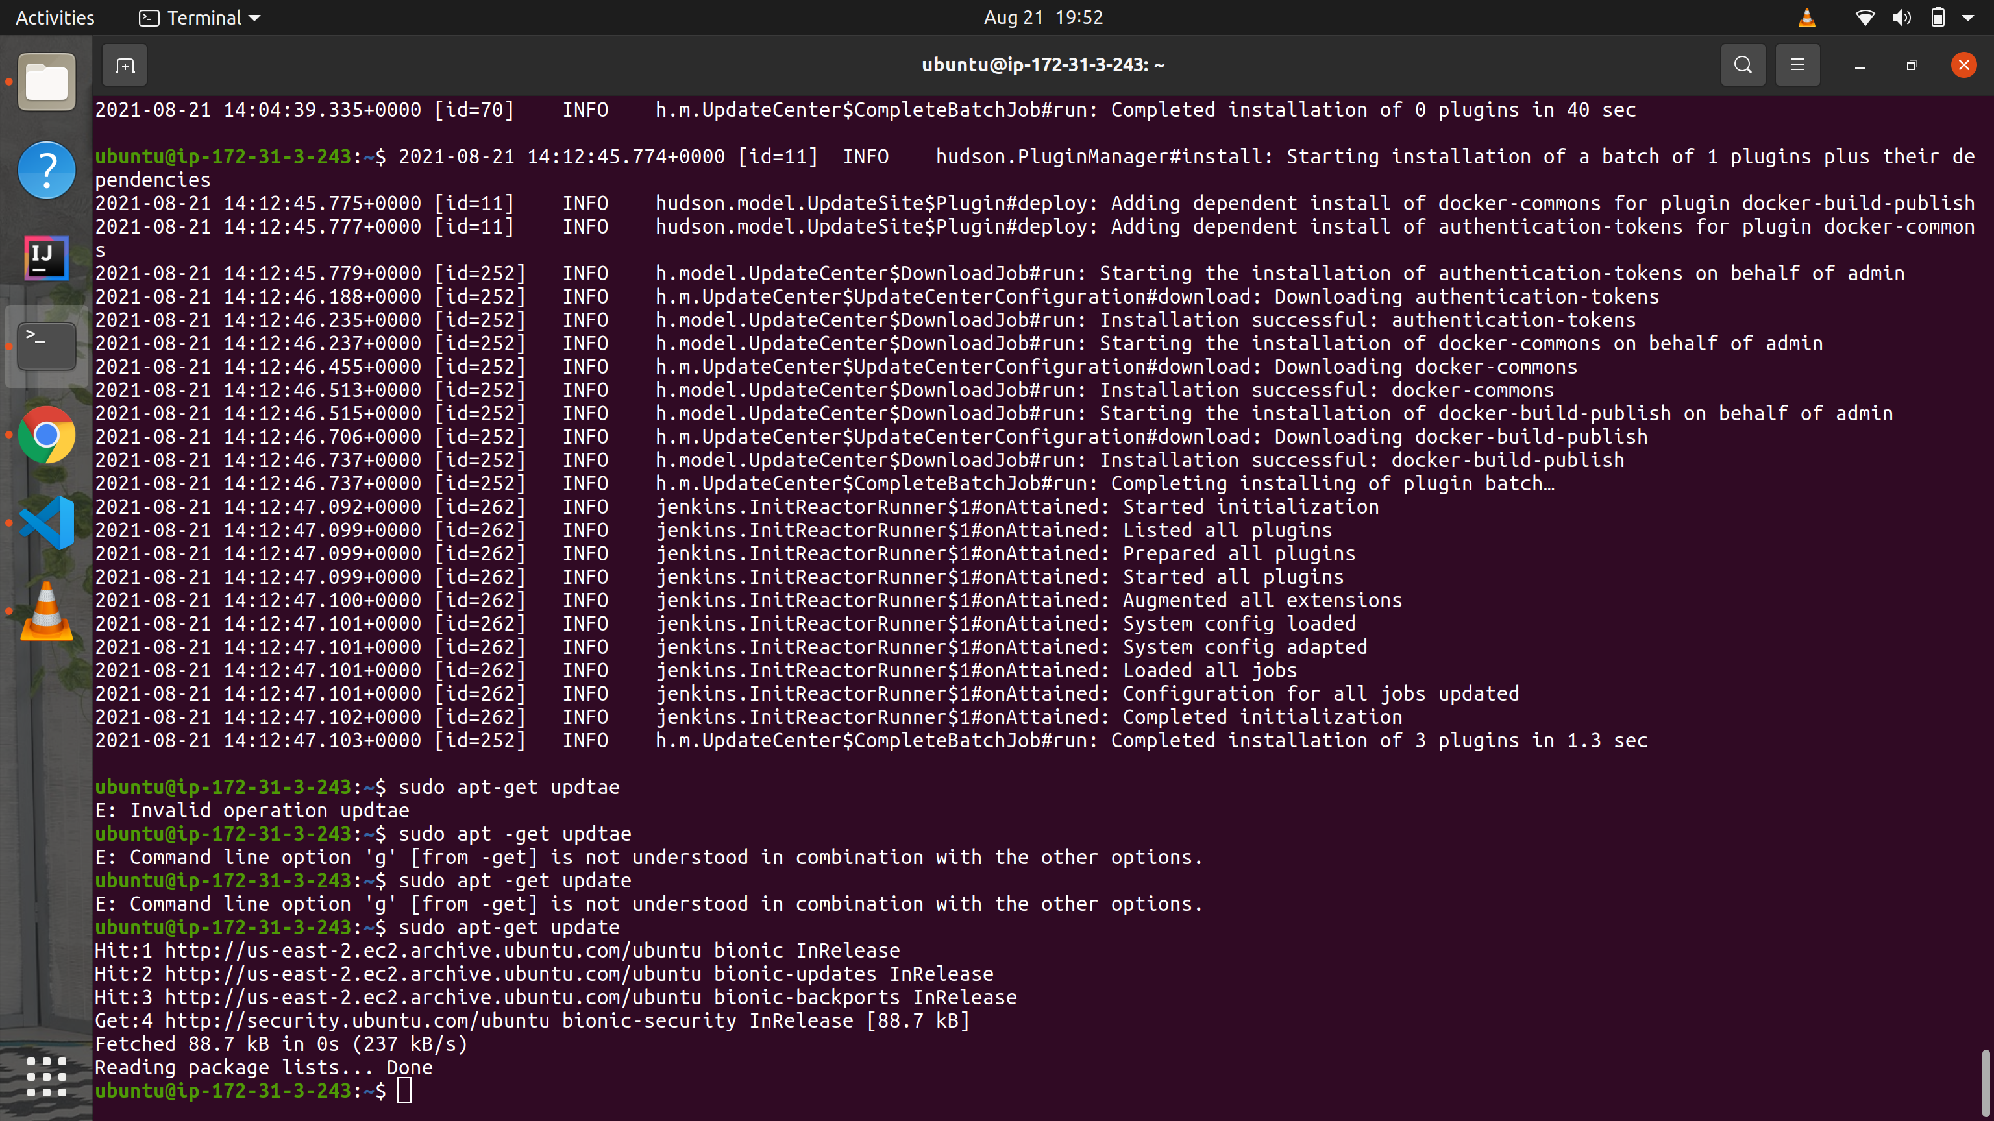
Step 11:

Slide 13
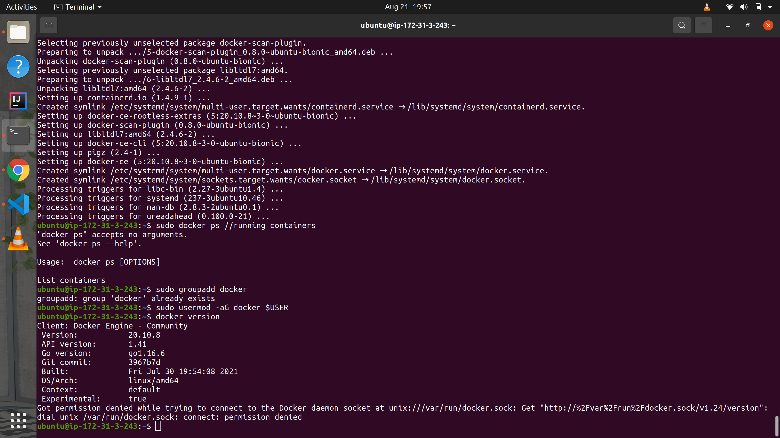
Step 12:

Slide 14
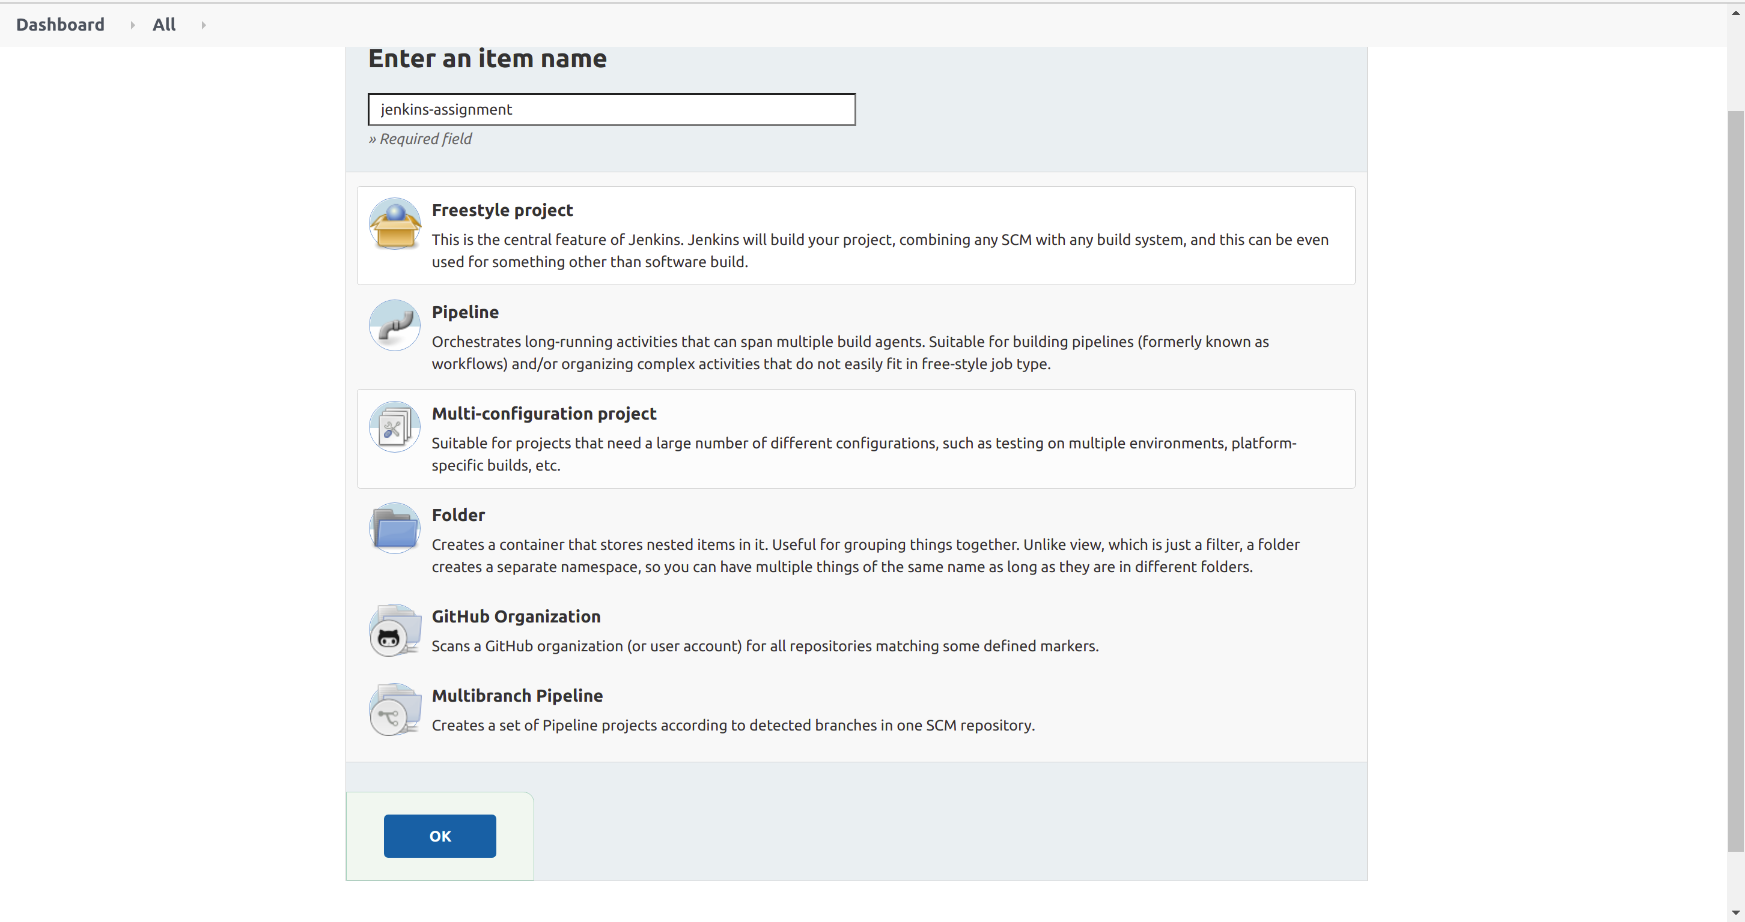
Step 13:

Slide 15
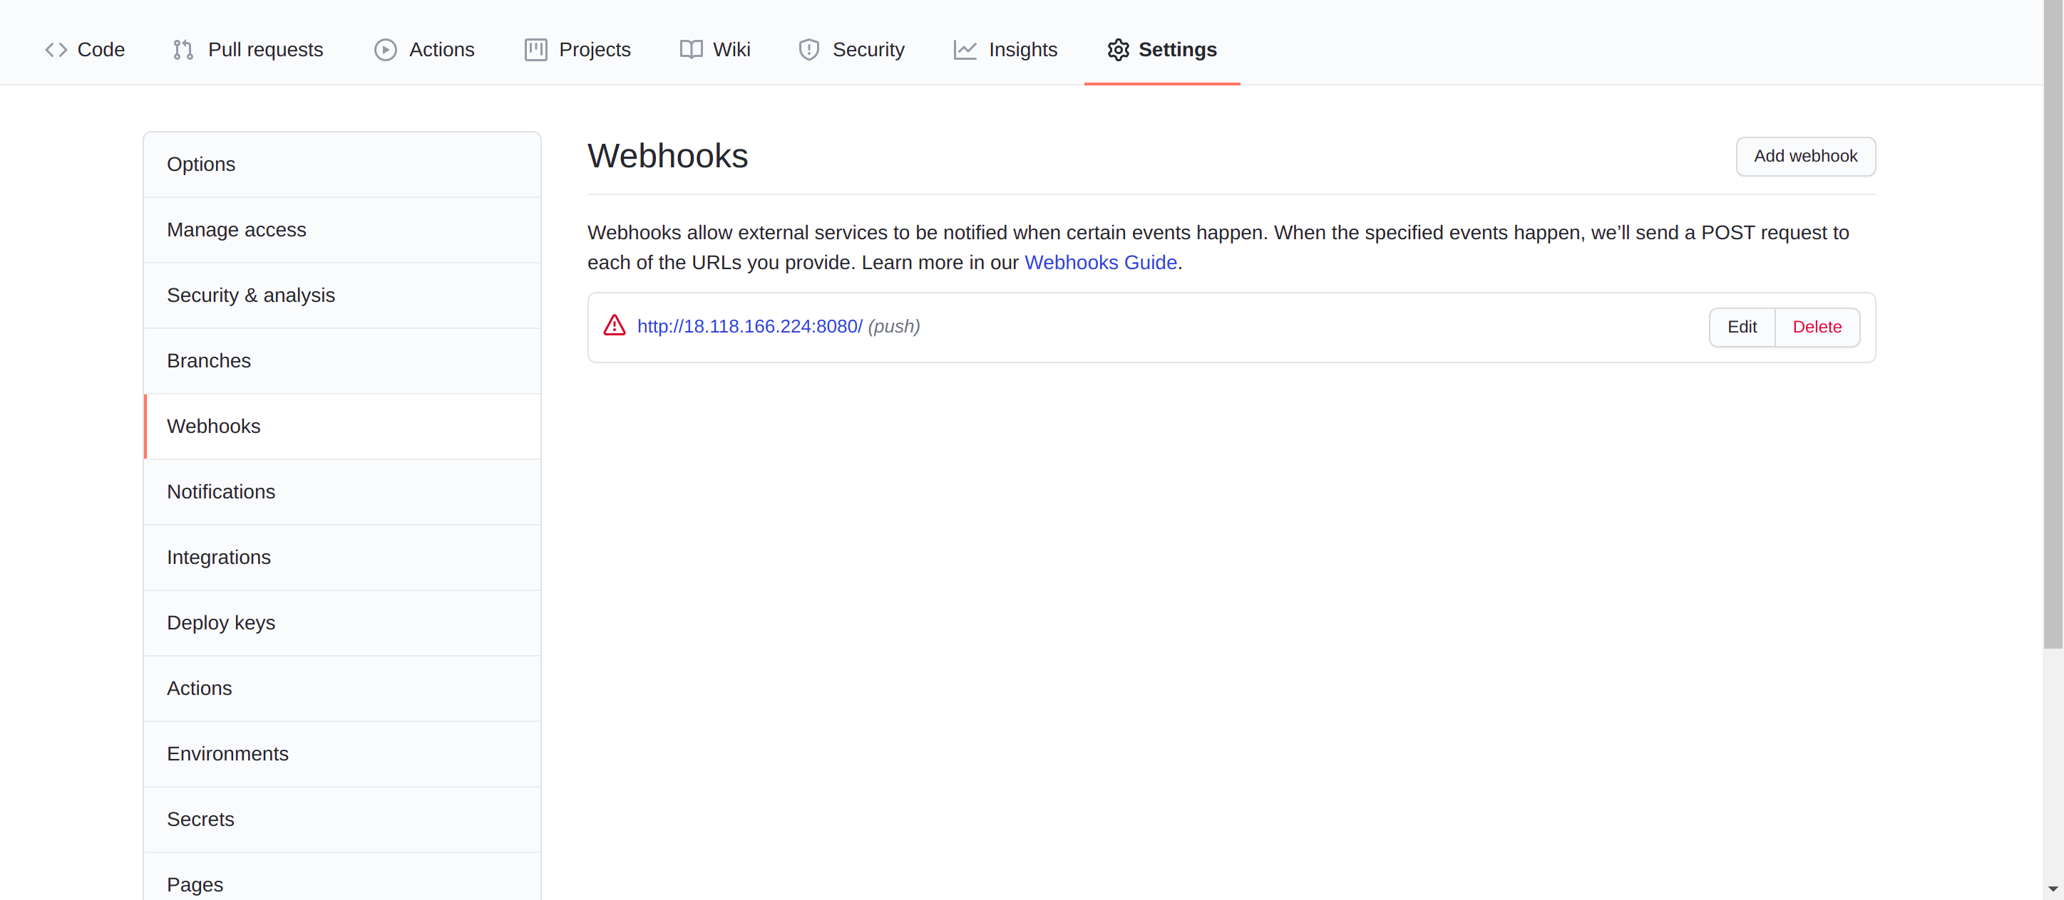
Step 14:

Slide 16
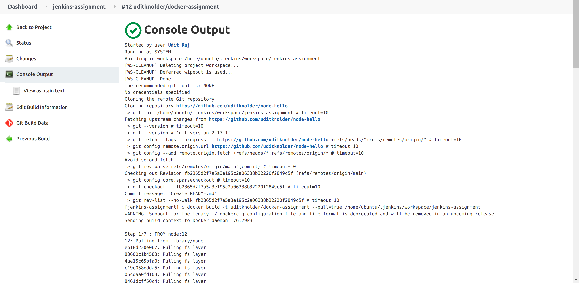
Step 15:

Slide 17
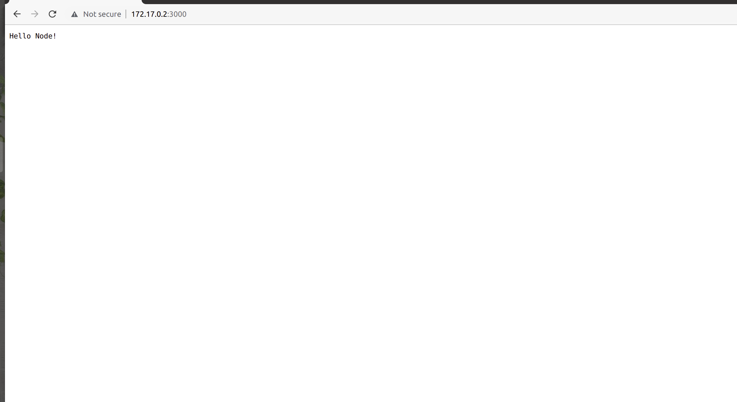
Step 16:

Slide 18
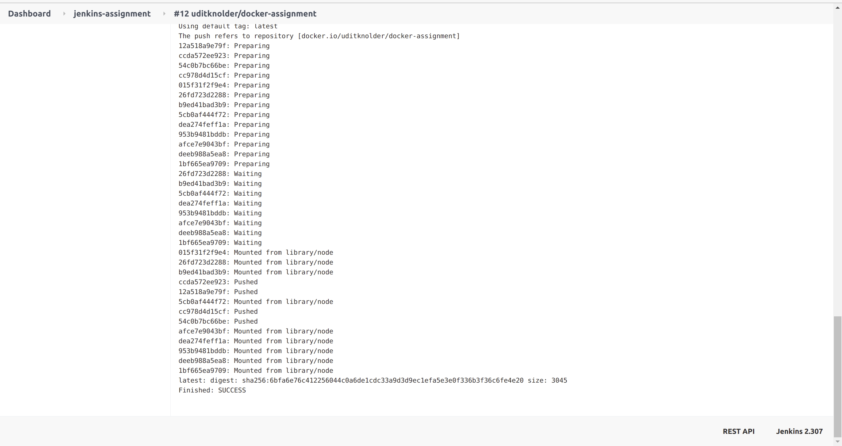
Step 17:

Slide 19
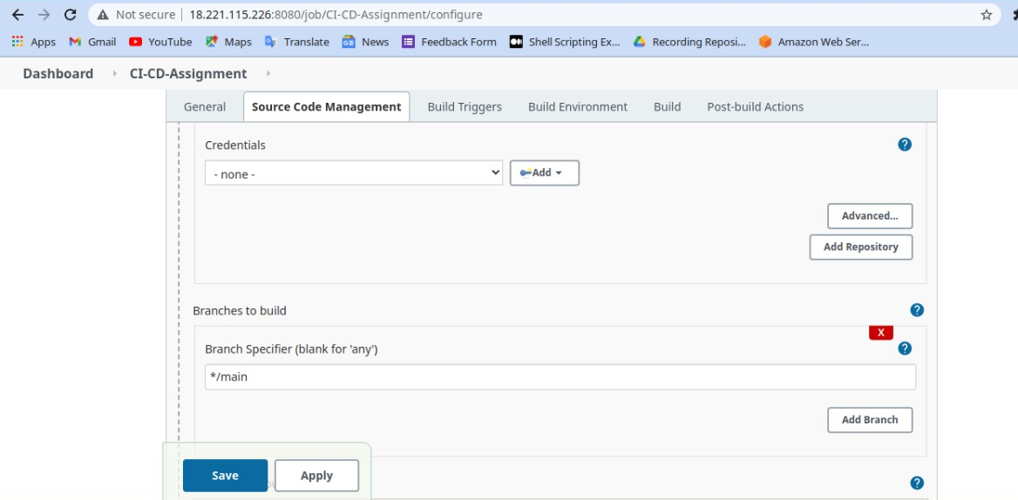
Step 18:

Slide 20
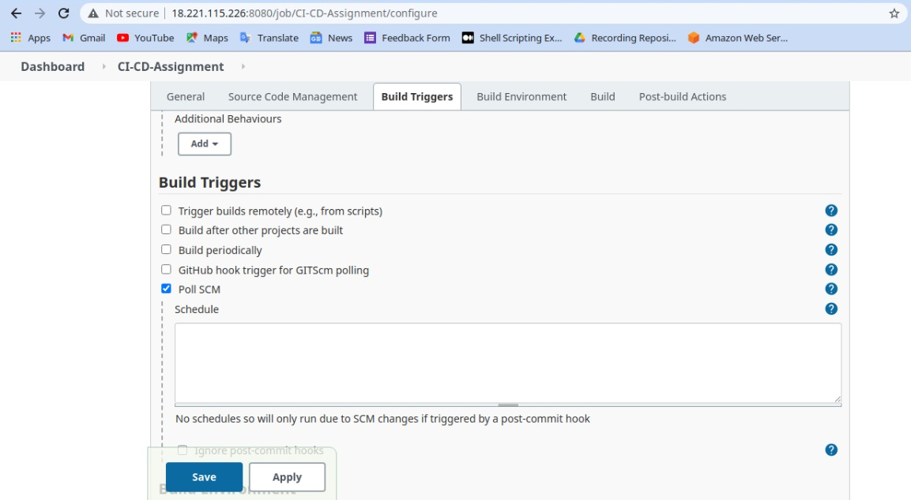
Step 19:

Slide 21
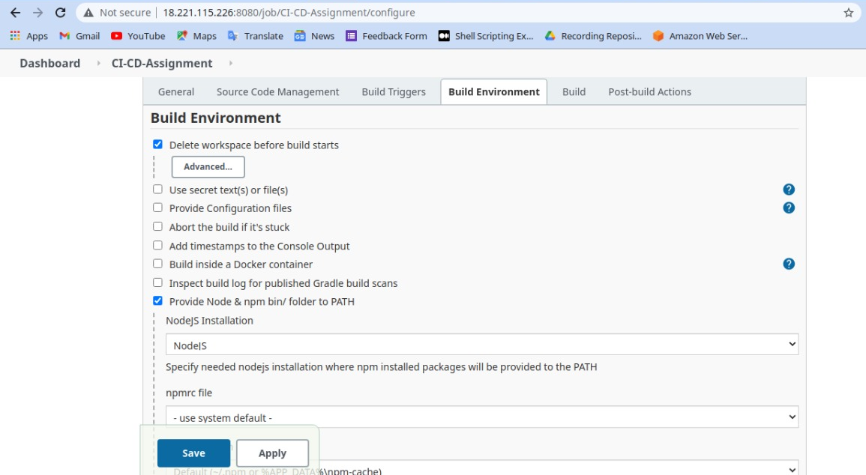
Step 20:

Slide 22
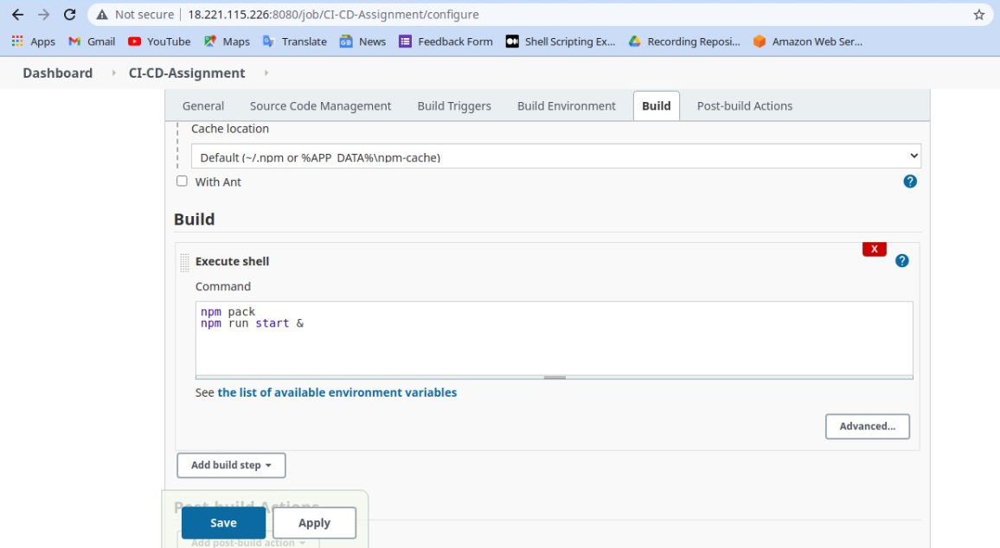
Step 21:

Slide 23
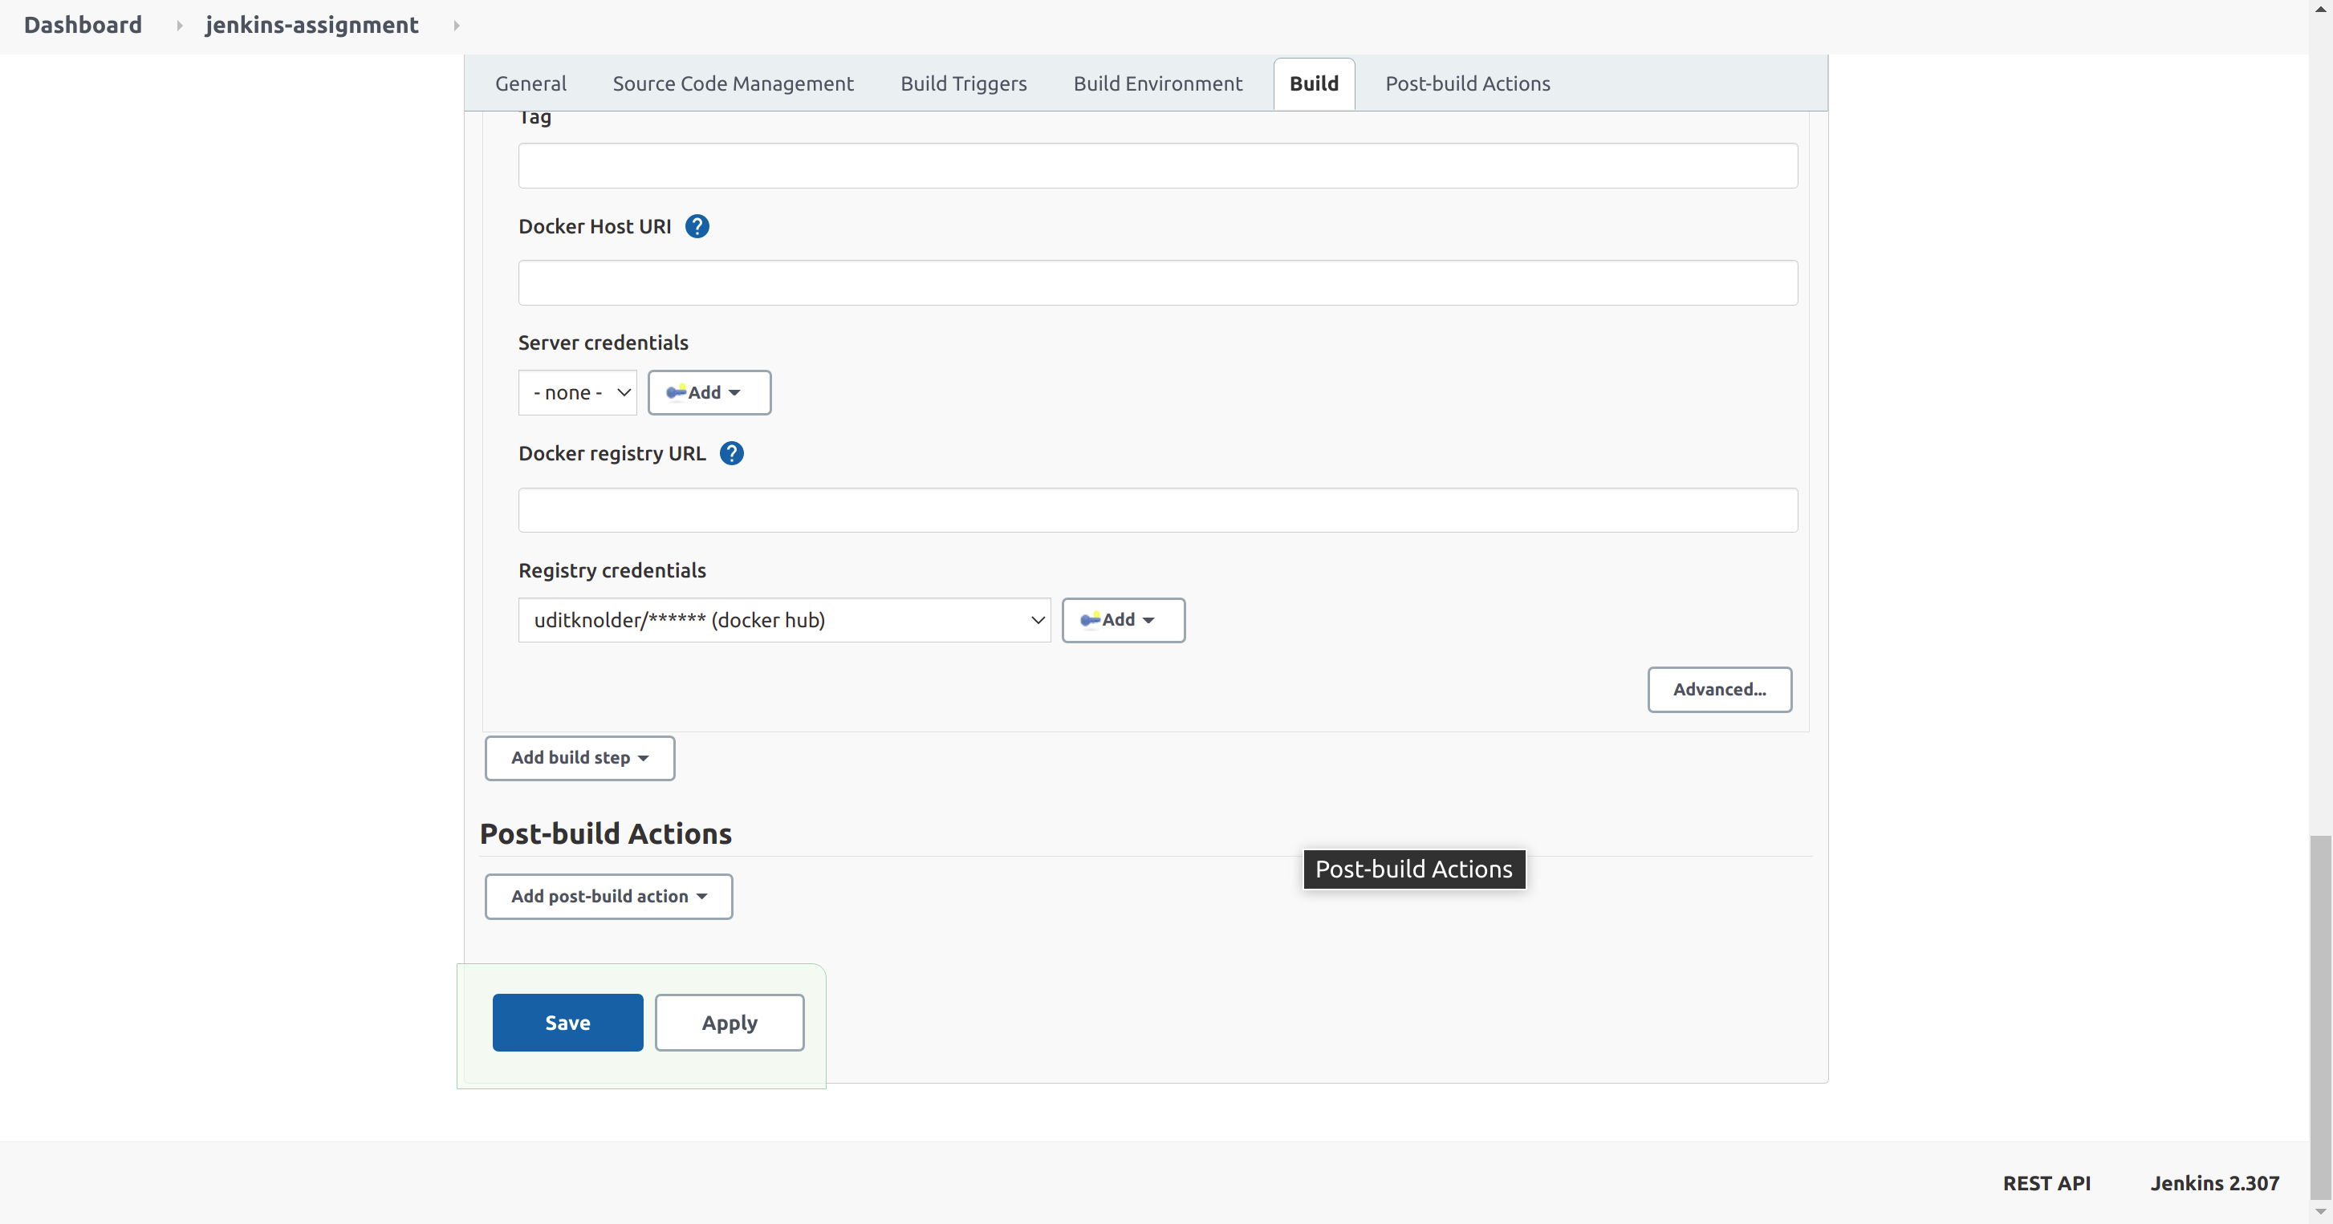
Step 22:

Slide 24
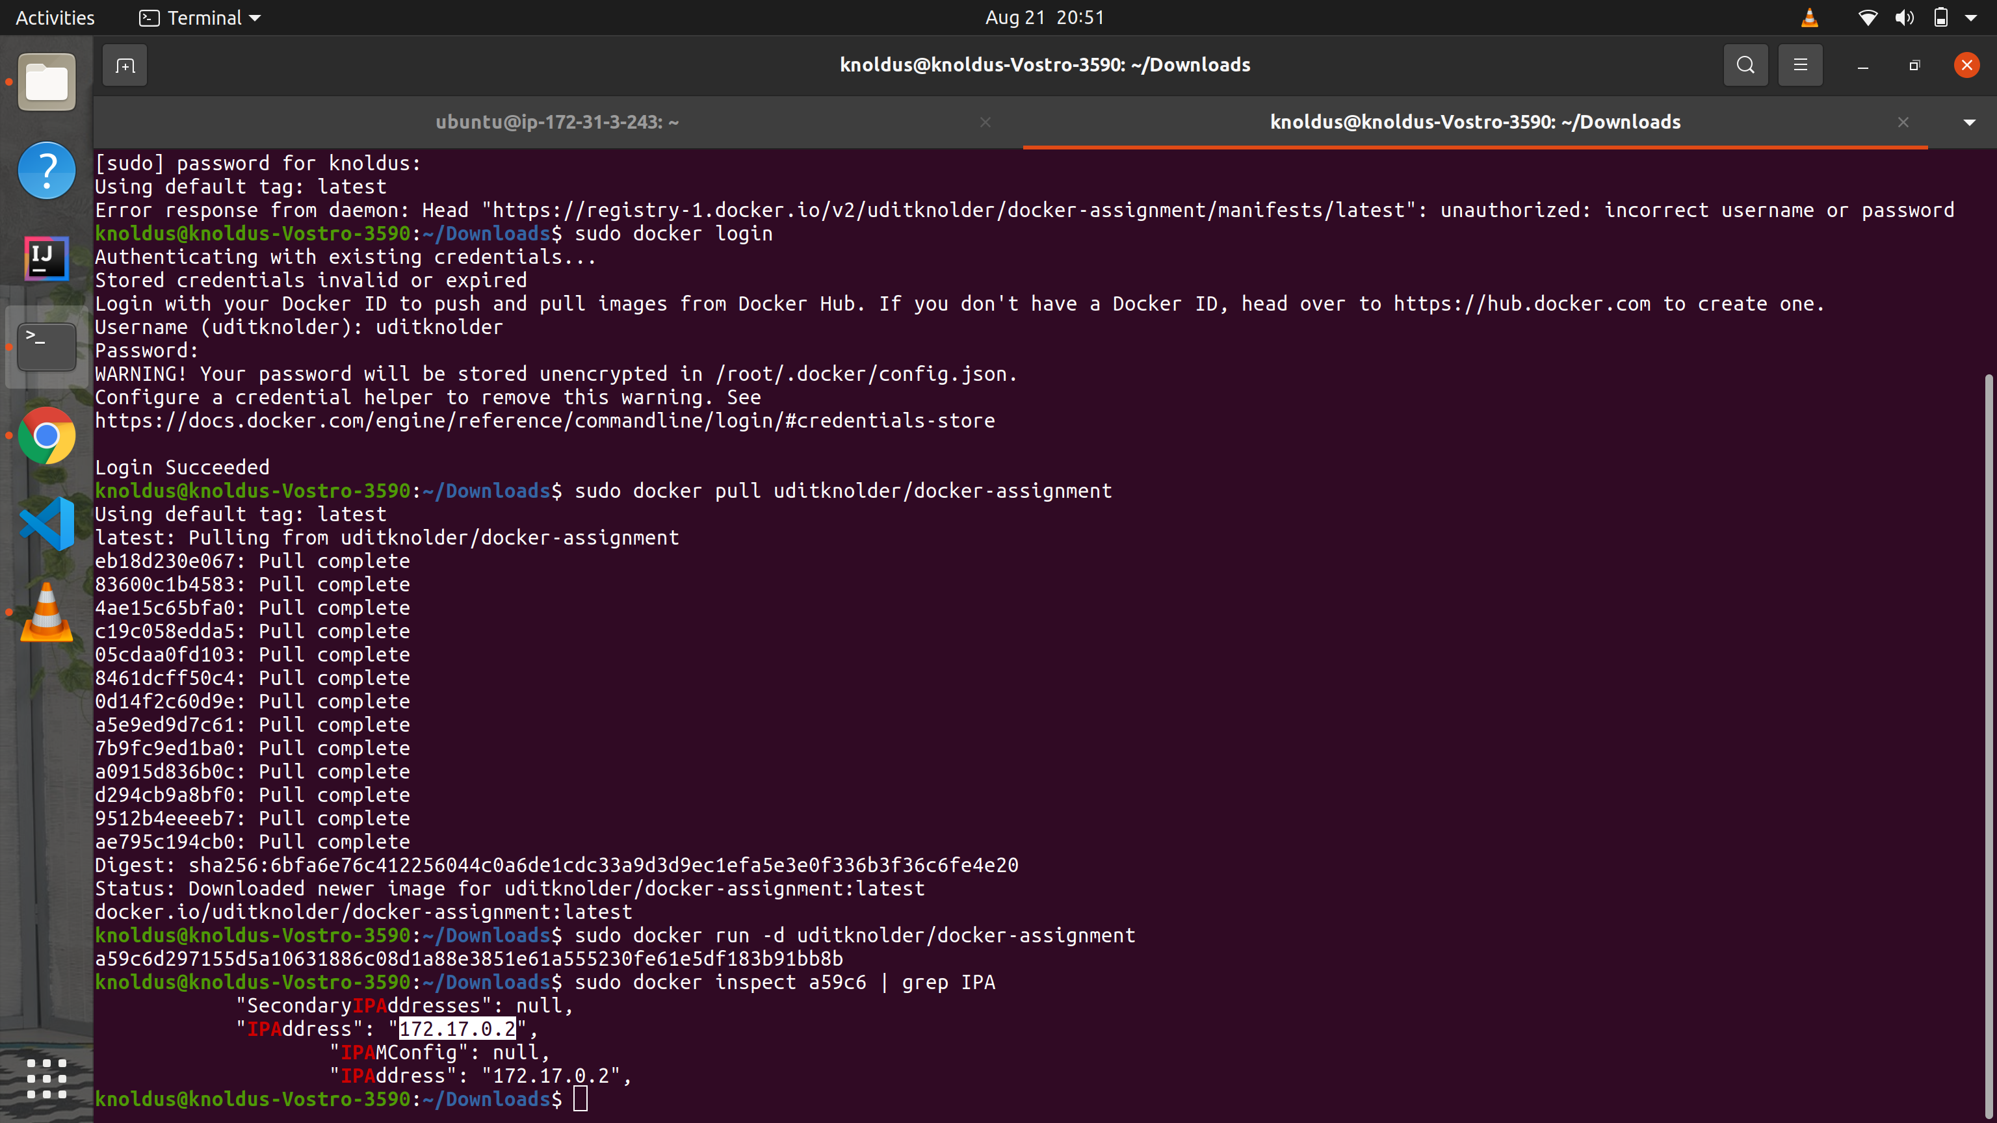
Step 23:

Slide 25

Thank You!
Stay in Touch
facebook.com/templateparade
@Temparade
Bouleverd of Good Dream, 89898
+6288 2546 0845

